Slide 1

GLA University
Railway Reservation System
Presented by
Mayank Varshney
Gantavya Sharma
Jyotiratidya Singh Jadon
Guided by
Mr. Manoj Varshney

Slide 2
Outline
Introduction
Objective
Technology Used

Slide 3
Introduction
Indian Railways is the state-owned railway company of India, which owns and operates most of the country's rail transport. It is overseen by the Ministry of Railways of the Government of India.
The railway reservation system facilitates the passengers To enquiry about the trains available based on source and destination, booking and cancellation of tickets, enquiry about the status of the booked ticket, etc. The case study aims to design and develop a database maintaining records of different trains, train status and passengers.
This project contains an introduction to the railway's reservation system. It is the computerized system of reserving the seats of train seats in advance.
It also provides an error message while entering invalid data. No formal knowledge is needed for the user to use this system. Thus, by this all it proves it is user-friendly.
The purpose of this project is to develop a front-to-back- end System for applications and queries using the graphical user interface......

Slide 4
Objective
1) it generates the report on Train, Booking Customer
2) Provide statement on Payment, Seat, Ticket Booking.
3) Editing, adding and updating of Records is improved which results in proper resource management of Train data.

Slide 5
Technology Used
PHP language
Webserver Xampp
Html-CSS
Code Editor
browser
net Adapter
Internet

Slide 6
Increased operational efficiency
Improve productivity from existing systems
Streamline and optimize business procedures
Responsiveness to constituents
Create end-to-end visibility into the business
Make the information accessible and actionable

Slide 7
Current Issues
Higher demand for Freight and Passenger transport, with planned economic growth
Need for capacity enhancement in the Railway network over the next 10-15 years
Technological uprgadation for better maintenance of railway assets
Greater competition from Roadways, with major investments in Highway network upgradation
Increase freight market share through higher availability of services at competitive prices
Greater attention to passenger services and safety

Slide 8
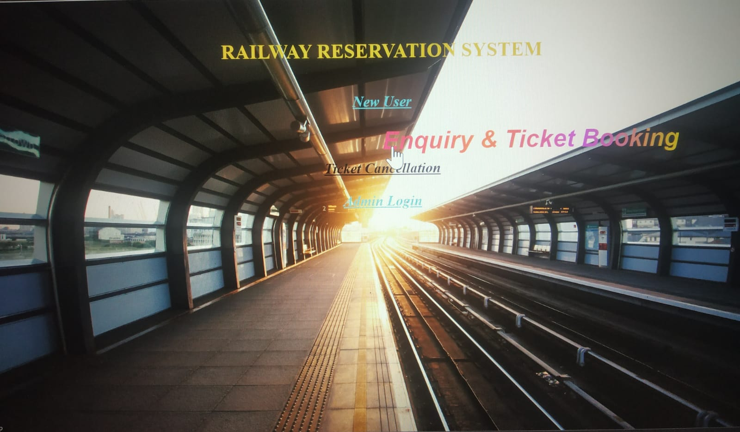
Home Page Index

Slide 9
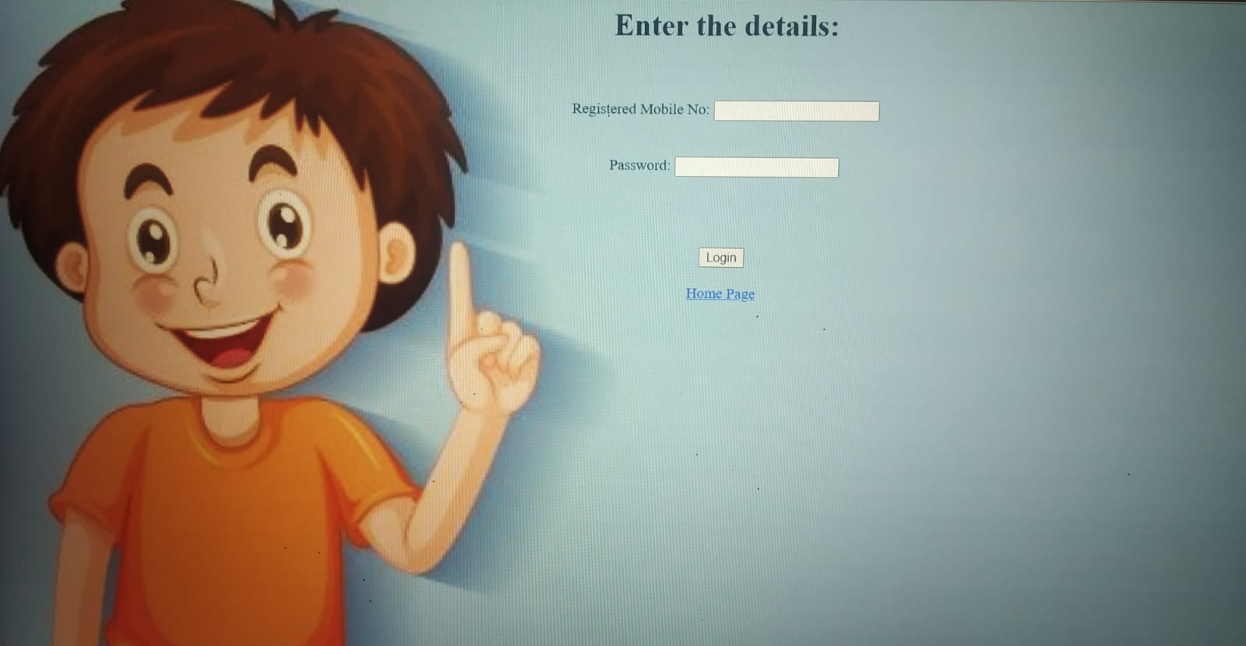
User Login Page

Slide 10
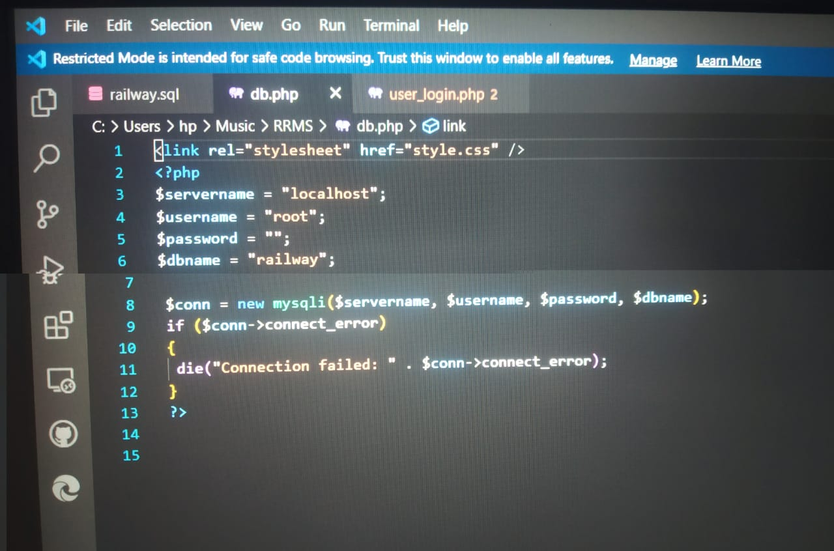
Database connection file code with username root and password null

Slide 11
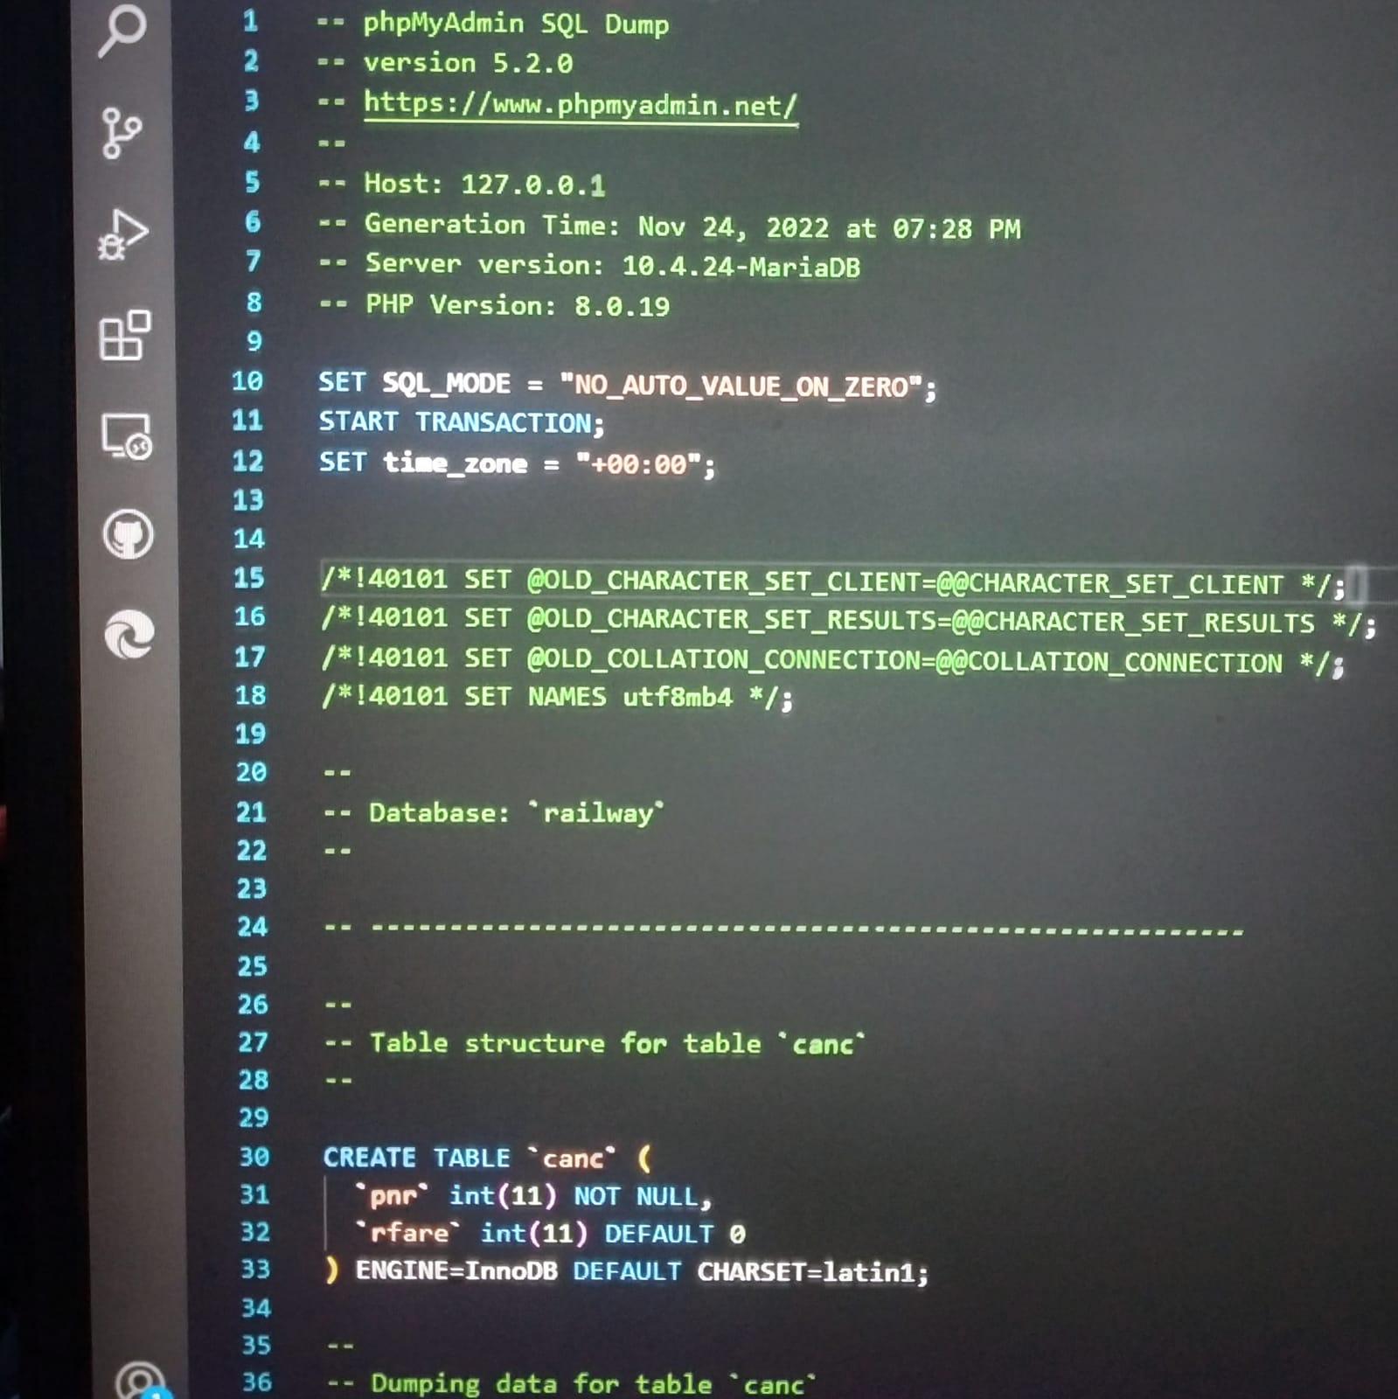
SQL database source file

Slide 12
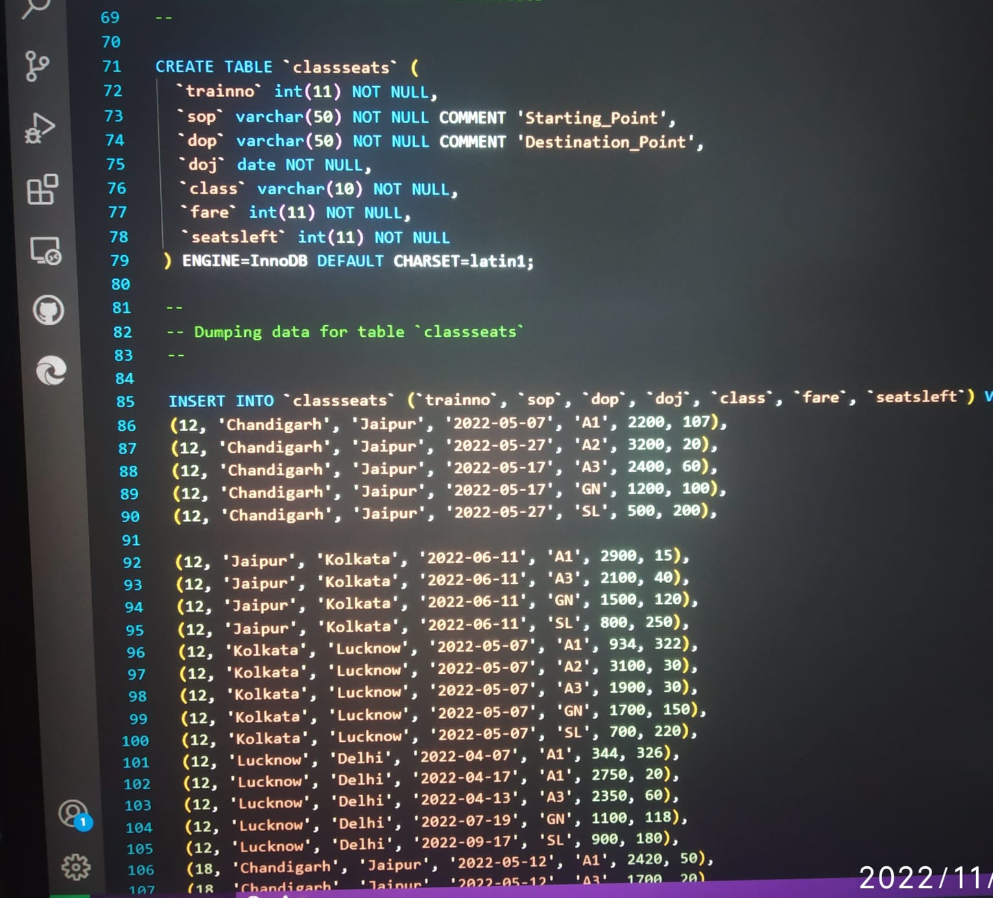
SQL query for table create and insert data value of train details

Slide 13
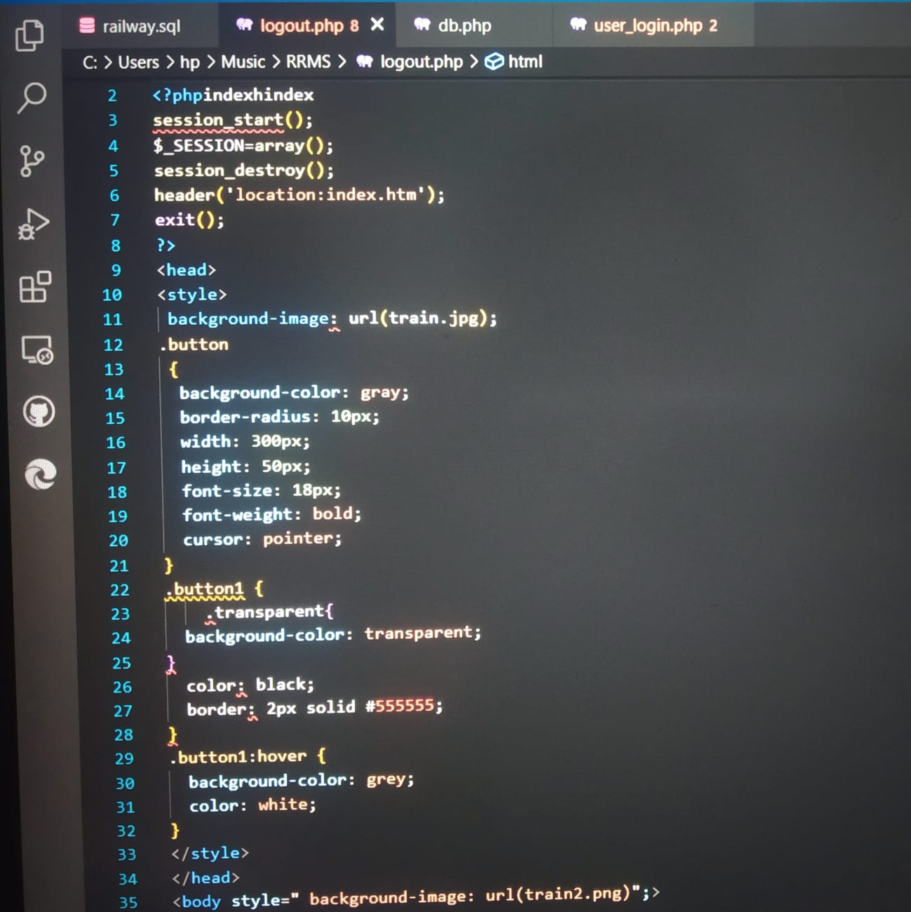
Logout page source code with html css

Slide 14
THANK YOU

